Slide 1
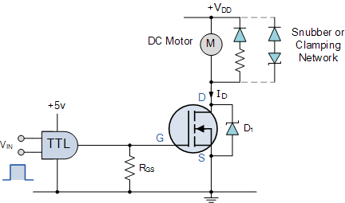
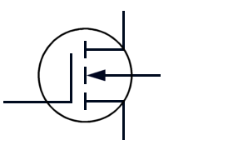
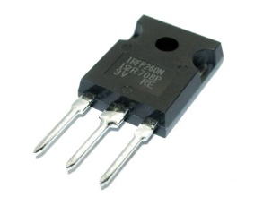
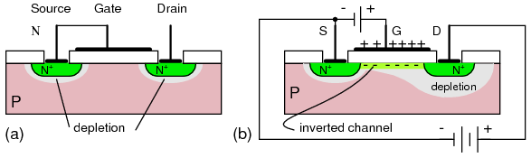
MOSFET

Slide 2
Field Effect Transistor (FET)
FET
JFET – Junction Field Effect Transistor:
n-channel
p-channel
MOSFET – Metal-Oxide-Semiconductor Field Effect Transistor:
Enhancement-type:
n-channel (NMOS)
p-channel (PMOS)
Depletion-type:
n-channel
p-channel

Slide 3
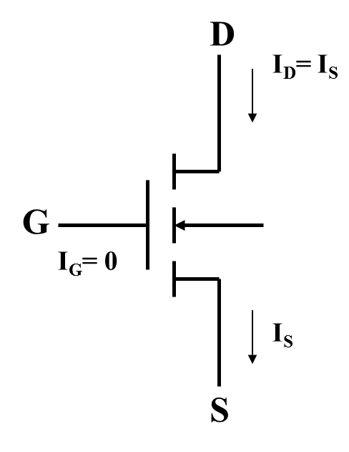
MOSFET
MOSFET stands for metal-oxide semiconductor field-effect transistor.
Unlike BJT which is ‘current controlled’, the MOSFET is a voltage controlled device.
The MOSFET has “gate“, “Drain”, “Source” and “Body” terminals.
G-Gate
D-Drain
S-Source
B-Substrate or Body

Slide 4
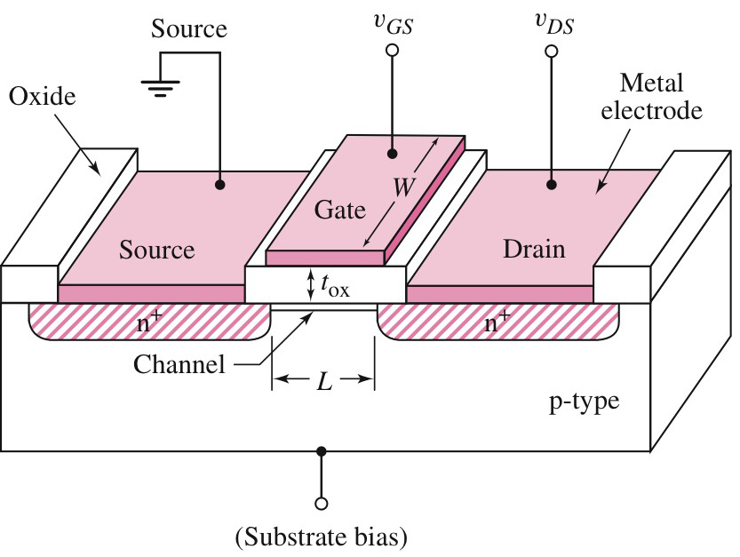
MOSFET
n-channel Enhancement-Type
Structure
p-type substrate
Two heavily-doped (n⁺) regions created in the substrate to form the drain and the source.
A thin (0.02 to 0.1 μm) layer of silicon dioxide (SiO₂) is grown on the surface of the substrate covering the area between the source and the drain.

Slide 5
MOSFET
n-channel Enhancement-Type
Structure
SiO₂ is an excellent insulator.
Metal is deposited on the top of the SiO₂ layer to form the gate electrode.
Metal contacts are also made to the source region, drain region and the substrate.
Terminals are from these metal contacts which form the drain (D), source (S), gate (G) and substrate or body (B) terminals.

Slide 6
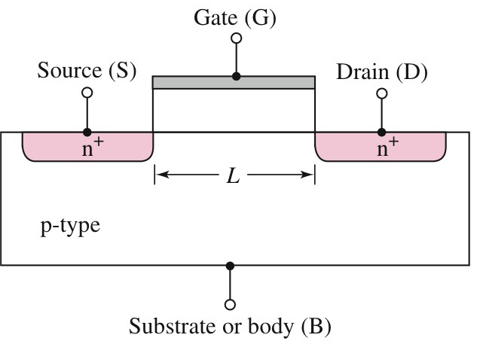
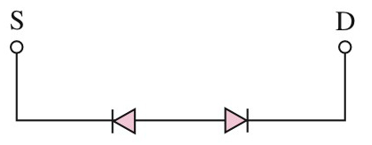
MOSFET
n-channel Enhancement-Type
Operation
With zero bias at the gate, the source and the drain are separated by the p-region – equivalent to two back-to-back diodes.
In this condition, the current is zero.

Slide 7
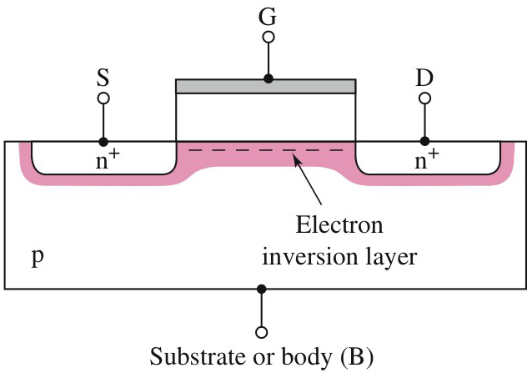
MOSFET
n-channel Enhancement-Type
Operation
A gate voltage is required to create a conduction path.
The carriers in the conduction path are electrons – hence the term n-channel MOSFET (NMOS).

Slide 8
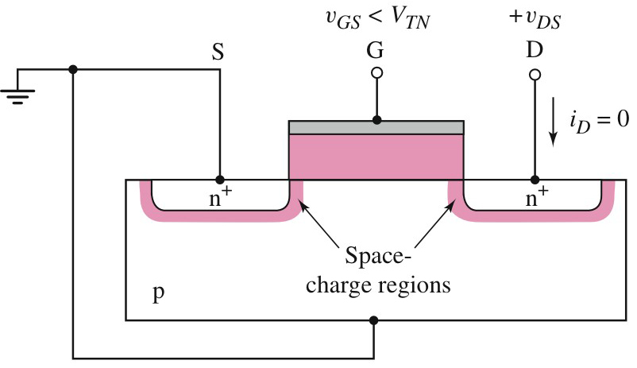
MOSFET
n-channel Enhancement-Type
Current–voltage characteristics
In order to create to create a conduction path between , the gate-to-source voltage (v_{GS}) must be applied to the gate of the transistor.
This voltage must be above a minimum value known as the threshold voltage (V_{TN}) which is positive for NMOS.
v_{GS} < V_{TN} the channel is not formed
Positive gate bias attracts electrons into channel.

Slide 9
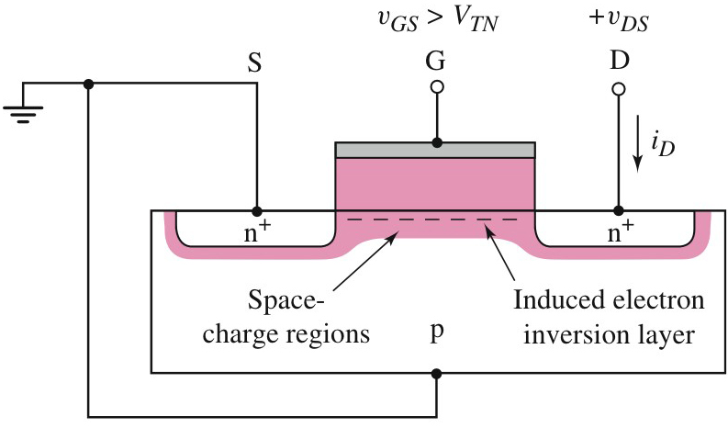
MOSFET
n-channel Enhancement-Type
Current–voltage characteristics
When v_{GS} exceeds V_{TN}, the channel is formed and current will flow if a voltage is applied between the drain and the source (v_{DS}).
This current is known as the drain current (i_{D})

Slide 10
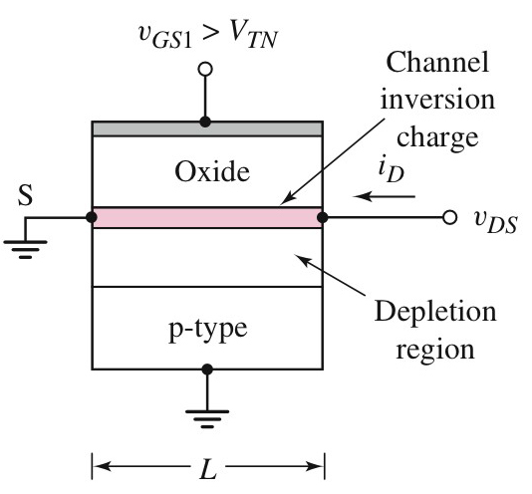
MOSFET
n-channel Enhancement-Type
Current–voltage characteristics
For small values of v_{DS}, the channel depth is constant over the whole length from the source to the drain.
Constant channel depth

Slide 11
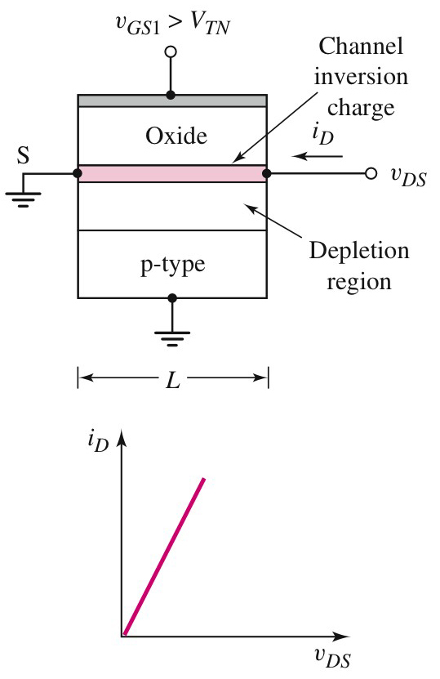
MOSFET
n-channel Enhancement-Type
Current–voltage characteristics
The constant channel depth causes the MOSFET to operate as a linear resistance (indicated by the linear relationship between i_{D} and v_{DS}) whose value is controlled by v_{GS}.
However, i_{D} is zero for v_{GS} < V_{TN} for any value of v_{DS}.

Slide 12
A voltage-controlled resistor @small V_{DS}
(Enhancement mode)
G
Positive gate bias attracts electrons into channel.
B
S
+
D
-
+++
V_{GS1}>V_{t}
I_{D}
+++
metal
decreasing
resistance
oxide
increasing
V_{GS}
p
n+
- - - -
n+
B
S
+
D
-
+++
V_{GS2}>V_{GS1}
+++
+++
metal
G
oxide
p
n+
- - - - - -
n+
V_{DS}
B
S
+
D
cut-off
-
0.1 v
+++
V_{GS3}>V_{GS2}
+++
+++
+++
metal
Increasing V_{GS} puts more charge in the channel, allowing more drain current to flow
oxide
p
n+
- - - - - - - - -
n+

Slide 13
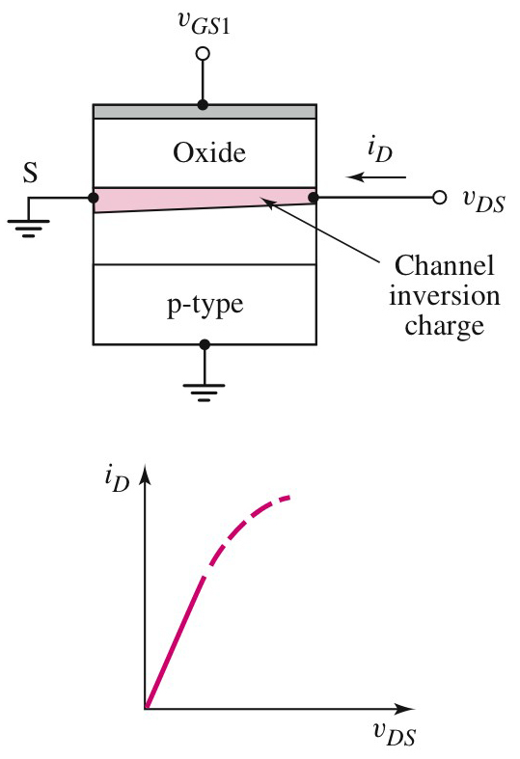
MOSFET
n-channel Enhancement-Type
Current–voltage characteristics
As the drain voltage increases, the voltage drop along the channel increases from 0 to v_{DS}.
The voltage between the gate and the points along the channel decreases from v_{GS} at the source end to (v_{GS} – v_{DS}) at the channel end, resulting in a decrease in channel depth at the drain (Figure).
This causes the conductivity to decrease.

Slide 14
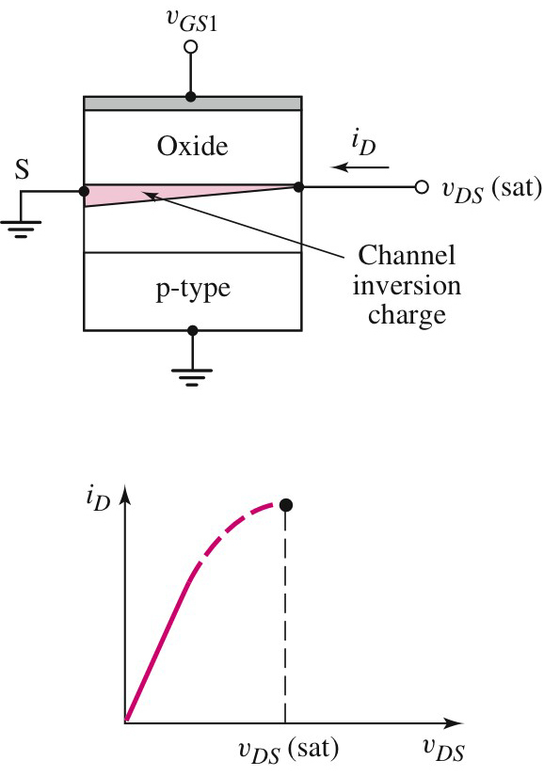
MOSFET
n-channel Enhancement-Type
Current–voltage characteristics
As the drain voltage increases to the point where v_{GS} – v_{DS} = V_{TN}, the channel depth will be zero.
The incremental conductivity is zero and the slope of the i_{D} versus v_{DS} curve is also zero. At the saturation point;
Or;

Slide 15
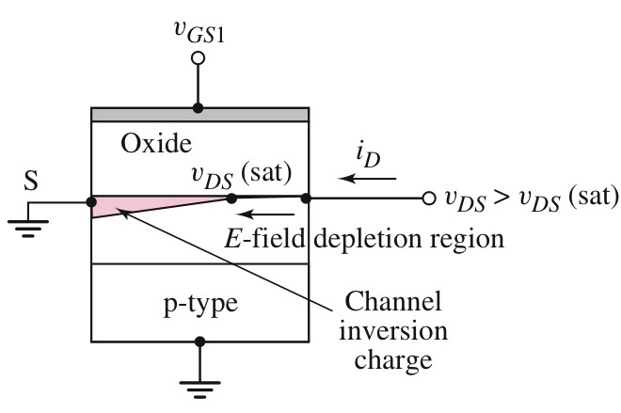
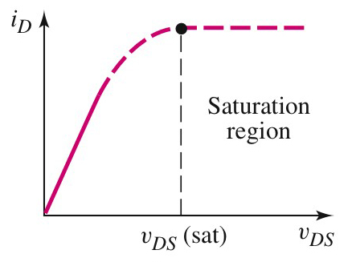
MOSFET
n-channel Enhancement-Type
Current–voltage characteristics
For v_{DS} > v_{DS}(sat), i_{D} is constant – saturation region

Slide 16
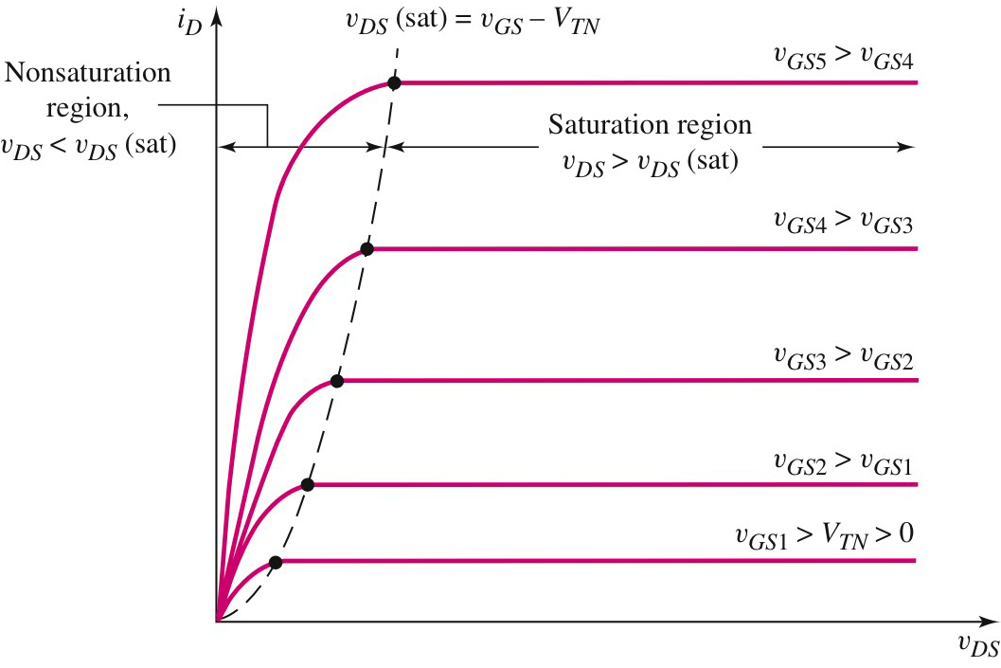
MOSFET
n-channel Enhancement-Type
Current–voltage characteristics
As the v_{GS} increases, the i_{D} increases.

Slide 17
MOSFET
n-channel Enhancement-Type
Current–voltage characteristics
The region where v_{DS} < v_{DS}(sat) is known as the triode region. For ideal MOSFET, the drain current i_{D} in this region is given by the expression;
The region where v_{DS} > v_{DS}(sat) is known as the saturation region. The drain current i_{D} in this region is given by the expression;

Slide 18
MOSFET
n-channel Enhancement-Type
Current–voltage characteristics
The parameter K_{n} is called conduction parameter which for NMOS, is given by the expression;
μ_{n} is the mobility of electrons in the inversion layer and C_{ox} is the oxice capacitance per unit area given by the expression;
ε_{ox} = oxide permittivity
t_{ox} = oxide thickness

Slide 19
MOSFET
n-channel Enhancement-Type
Current–voltage characteristics
If we write;
the expression for K_{n} becomes;
The expression for the drain current in the saturation region becomes;

Slide 20
Field Effect Transistor (FET)
FET
JFET – Junction Field Effect Transistor:
n-channel
p-channel
MOSFET – Metal-Oxide-Semiconductor Field Effect Transistor:
Enhancement-type:
n-channel (NMOS)
p-channel (PMOS)
Depletion-type:
n-channel
p-channel

Slide 21
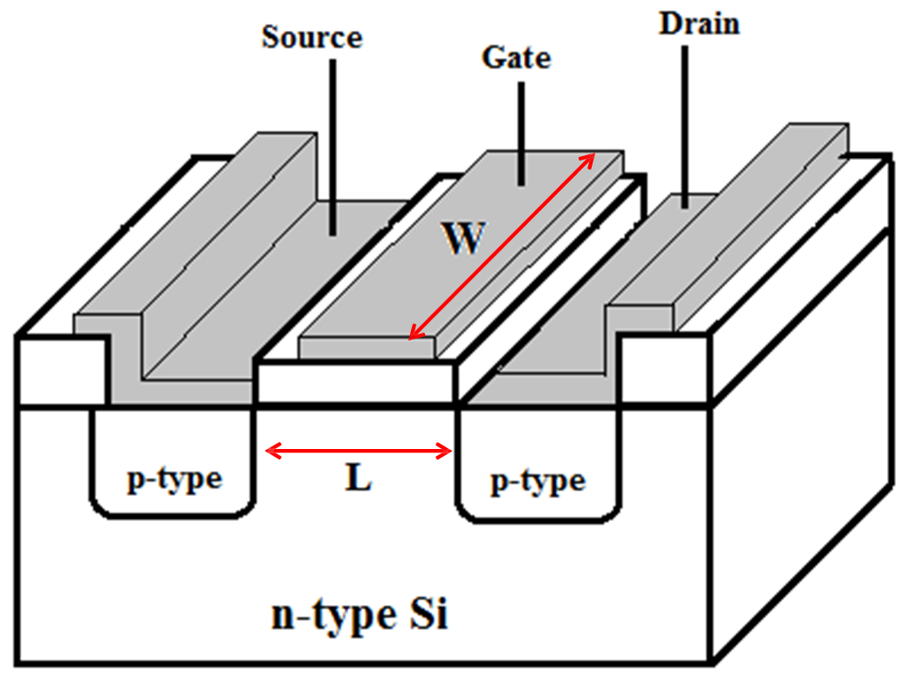
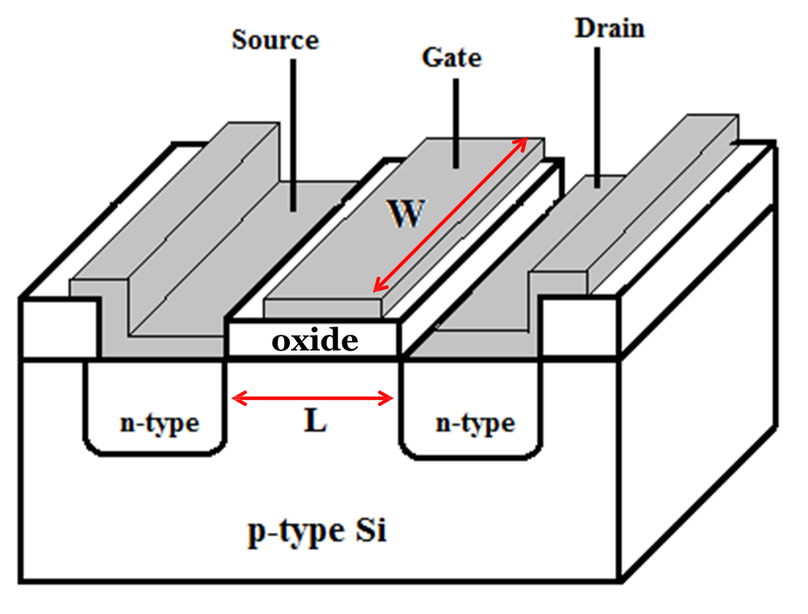
Cross-Sectional View of n channel Enhancement Mode Transistor
Cross-Sectional View of
p channel Enhancement Mode Transistor
Enhancement mode
Also known as Normally Off transistors.
▫ A voltage (at least equal to the threshold voltage) must be applied to the gate of the transistor to create a conduction path between the source and the drain of the transistor.

Slide 22
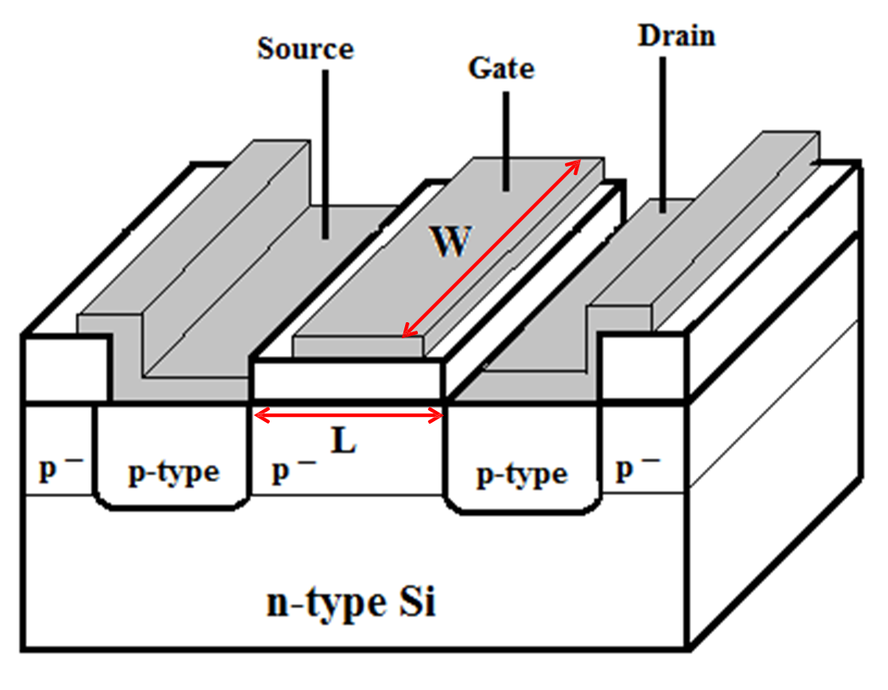
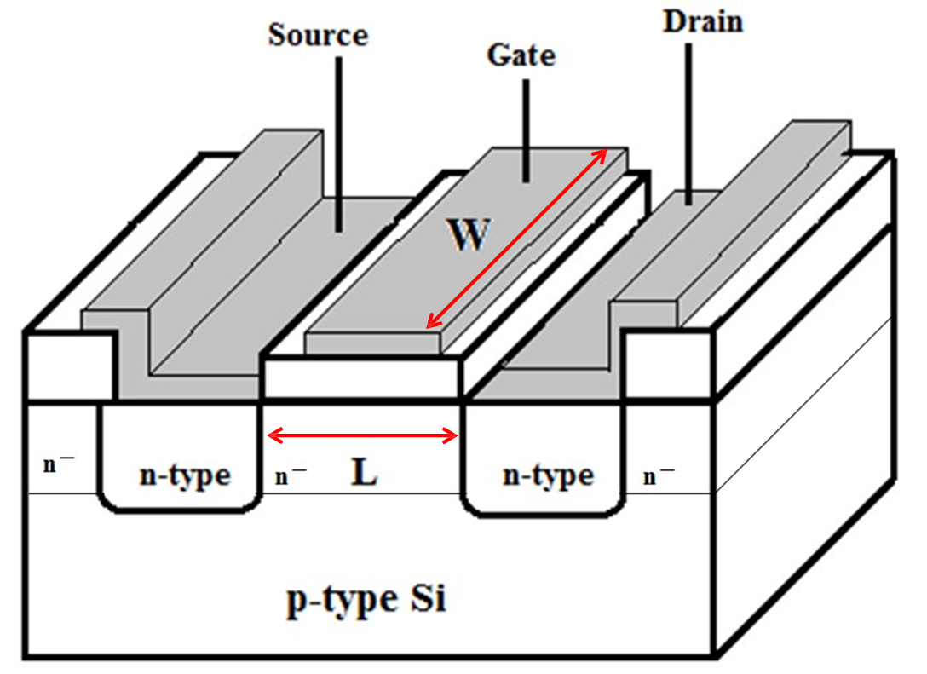
p channel Depletion Mode Transistor
n channel Depletion Mode Transistor
Depletion mode
Also known as Normally On transistors.
In order to prevent current from flowing between the source and drain, a voltage (at least equal to the threshold voltage) must be applied to the gate of the transistor to destroy the conduction path between the source and the drain.

Slide 23
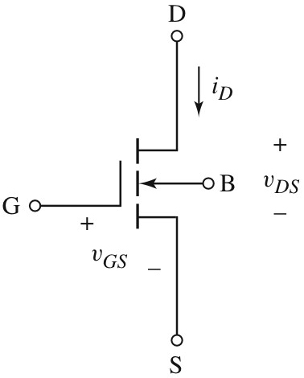
MOSFET
n-channel Enhancement-Type
Circuit symbols and Conventions
Conventional symbol
Vertical broken line – the channel (broken line indicates the enhancement type
Arrowhead – polarity between the substrate and channel
Vertical solid line – gate electrode
V_{GS} ≥ 0V, V_{DS} ≥ 0V
V_{TN} is positive
Separation – oxide layer

Slide 24
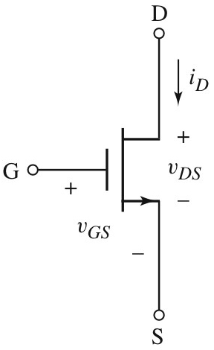
MOSFET
n-channel Enhancement-Type
Circuit symbols and Conventions
In many cases, the substrate and source terminals are connected together. The circuit symbol can be simplified.
The arrowhead is in the source terminal and direction indicates the direction of current.
V_{GS} ≥ 0V, V_{DS} ≥ 0V
V_{TN} is positive

Slide 25
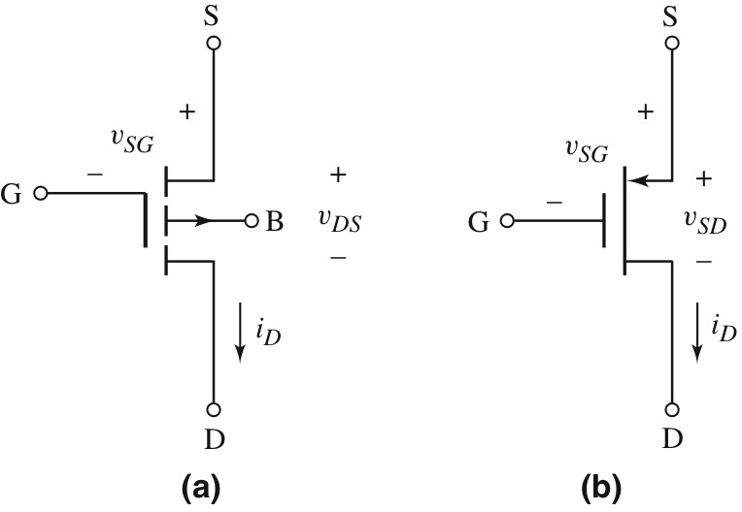
MOSFET
p-channel Enhancement-Type
Circuit symbols and Conventions
V_{GS} ≤ 0V, V_{DS} ≤ 0V
V_{TP} is negative

Slide 26
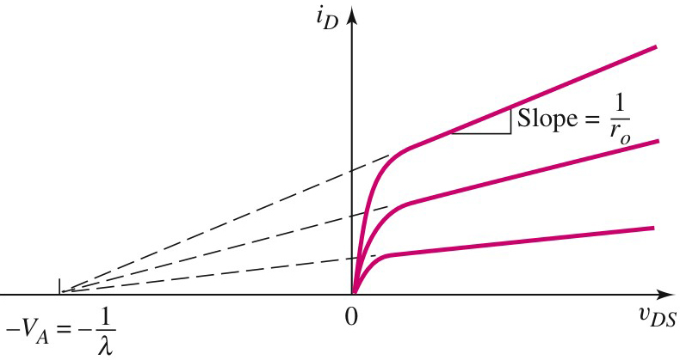
MOSFET
n-channel Enhancement-Type
Non-ideal Current–voltage characteristics
The drain current i_{D} is dependent on the drain-to-source voltage v_{DS} due to channel length modulation.
Non-zero slope exists in the actual i_{D} versus v_{DS} characteristics beyond saturation point.

Slide 27
MOSFET
n-channel Enhancement-Type
Non-ideal Current–voltage characteristics
Extrapolation on the characteristic curves produce a point of interception on the voltage axis at –V_{A}.
λ is the channel-length modulation parameter

Slide 28
MOSFET
n-channel Enhancement-Type
Non-ideal Current–voltage characteristics
In the saturation region, the drain current may expressed as;

Slide 29
MOSFET
n-channel Enhancement-Type
Non-ideal Current–voltage characteristics
The output resistance r_{o} is the inverse of the slope of the characteristics curves;

Slide 30
MOSFET
n-channel Enhancement-Type
Non-ideal Current–voltage characteristics
Differentiating the expression for i_{DS} at the Q-point, gives us;
or

Slide 31
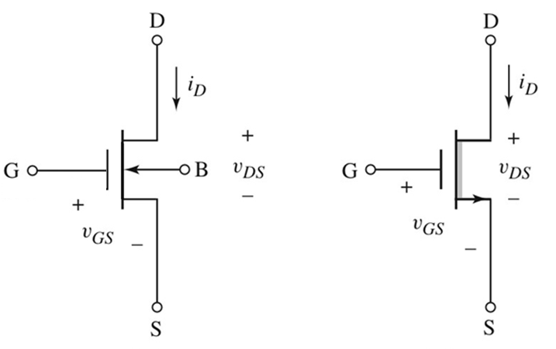
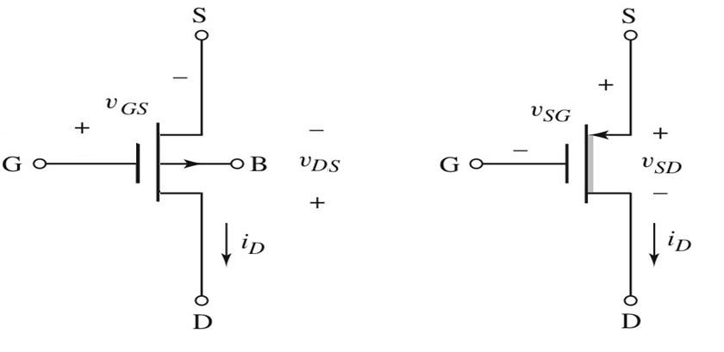
Symbols for n channel Depletion Mode MOSFET
in order to destroy the channel, gate voltage must be negative and less than the threshold voltage
Symbols for p channel Depletion Mode MOSFET
An enhancement MOSFET and a depletion MOSFET are precisely identical in nearly every way (e.g., same modes, same equations, same terminal names).
Except: The threshold voltage for a depletion NMOS device is negative (i.e., V_{t} <0). While the threshold voltage for a depletion PMOS device is positive (i.e., V_{t} > 0).

Slide 32
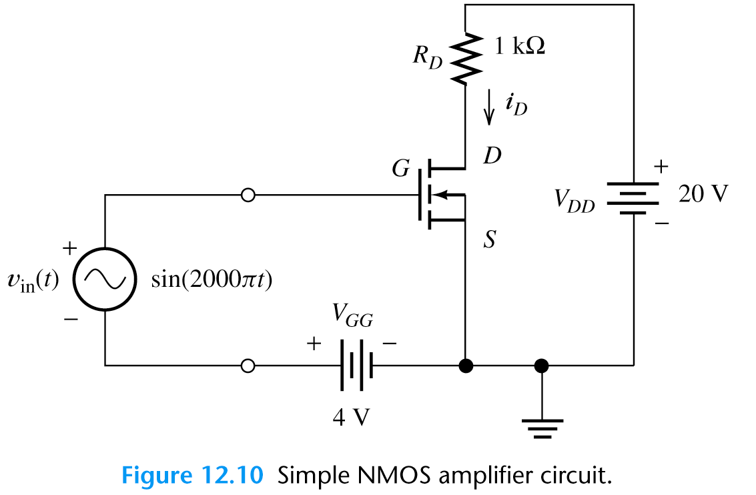
Load-Line Analysis
It is a graphical analysis similar to load-line analysis of pn diode.
We look for the operating point
Circuit Analysis:
v_{GS}
v_{DS}
Input
loop
Output loop
Load line

Slide 33
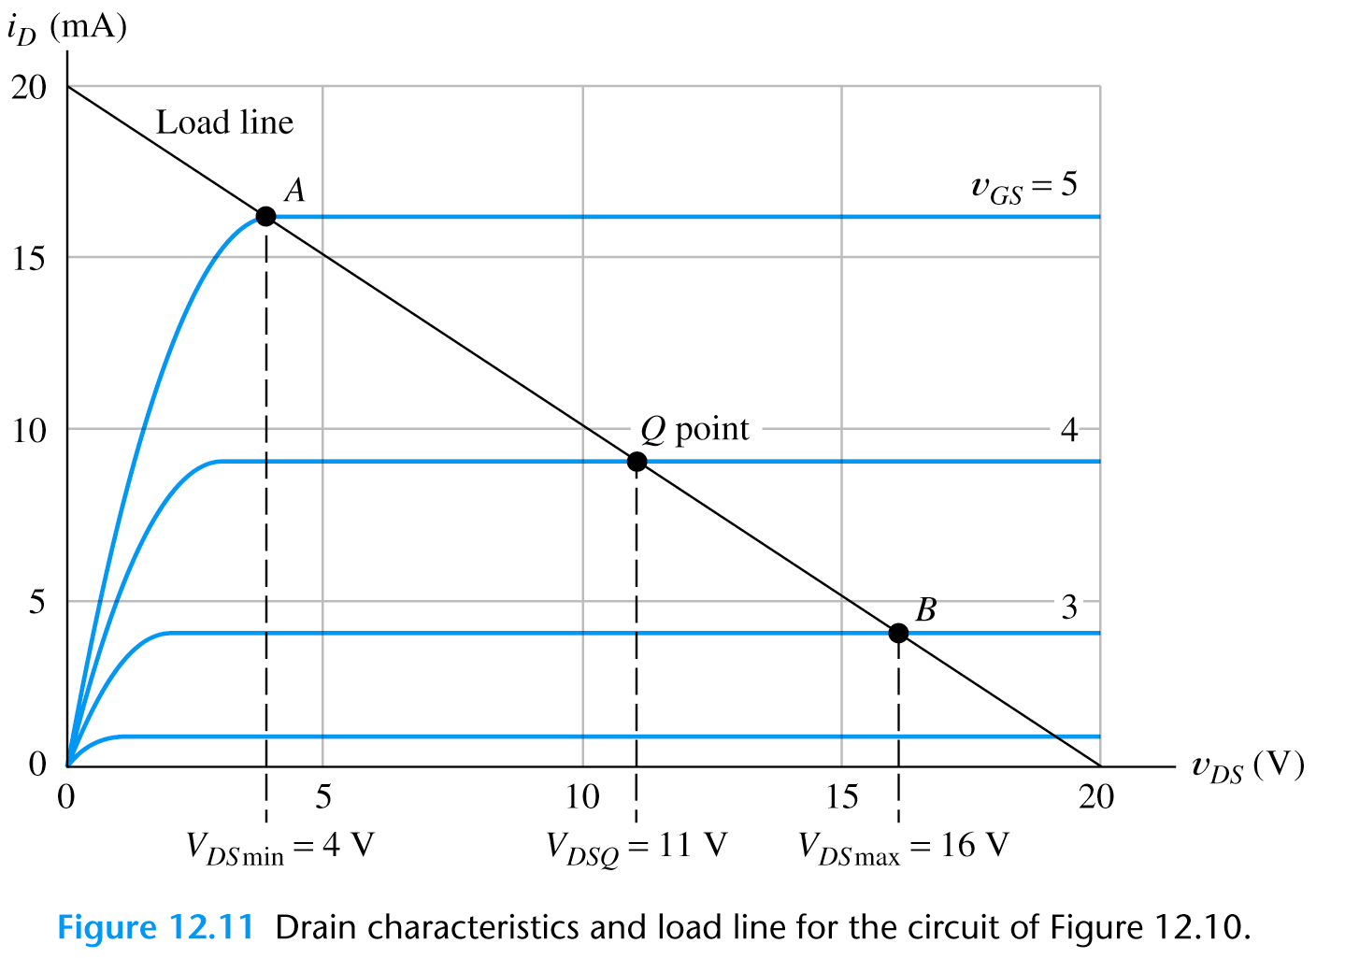
Load-Line Analysis
Exercise:
Draw the Load line
R_{D}= 1 kΩ

Slide 34
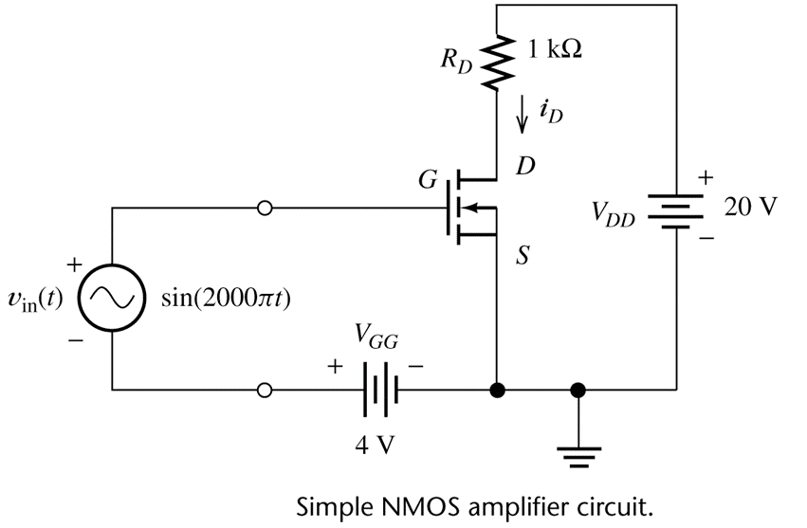
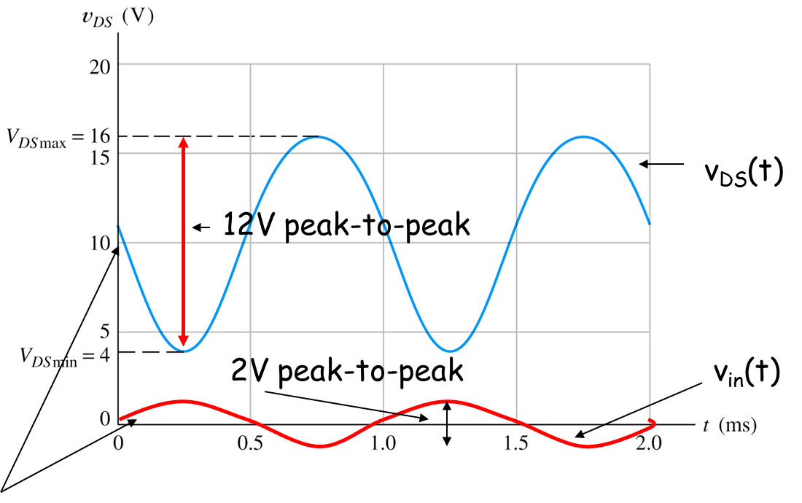
Load-Line Analysis
Load line
Taking i_{D}=0 or v_{DS}=0 we draw the load line and the operating point Q for V_{GS}=4V
Points A & B intersection of curve and the load-line for the maximum and the minimum gate voltage

Slide 35
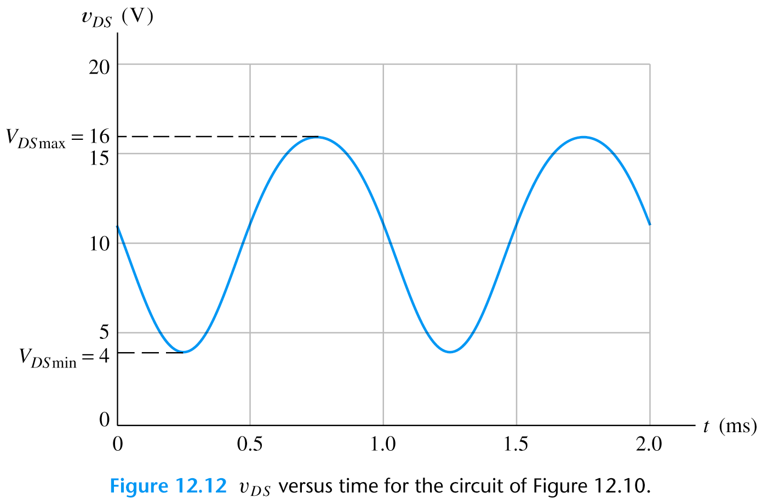
Load-Line Analysis
Input signal
(peak-to-peak amplitude is 2V)
v_{DS}(t)
12V peak-to-peak
2V peak-to-peak
v_{in}(t)
Inverse operation
The positive peak of the input occurs at the same time as the min. value of v_{DS}.

